Slide 1
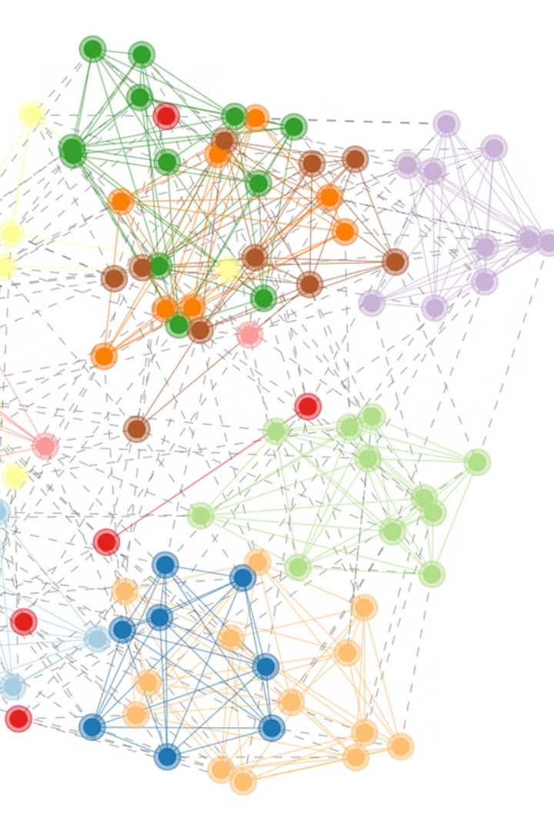
Constructing Independent Spanning Trees
Parallel Algorithm and Scalable Strategy with MPI + OpenMP Hybrid Parallelization.
by 22i-0919, 22i-0913

Slide 2
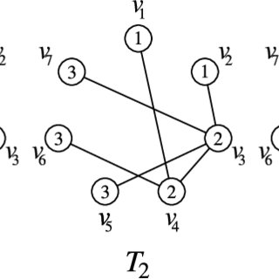
Designing Fault-Tolerant Secure Networks with MISTs
Challenge: Create fault-tolerant, secure networks with disjoint paths
Solution: Utilize Multi-path routing and Multiple Independent Spanning Trees (MISTs)
Limitation: Existing recursive MIST algorithms lack parallelization in Bubble Sort Networks

Slide 3
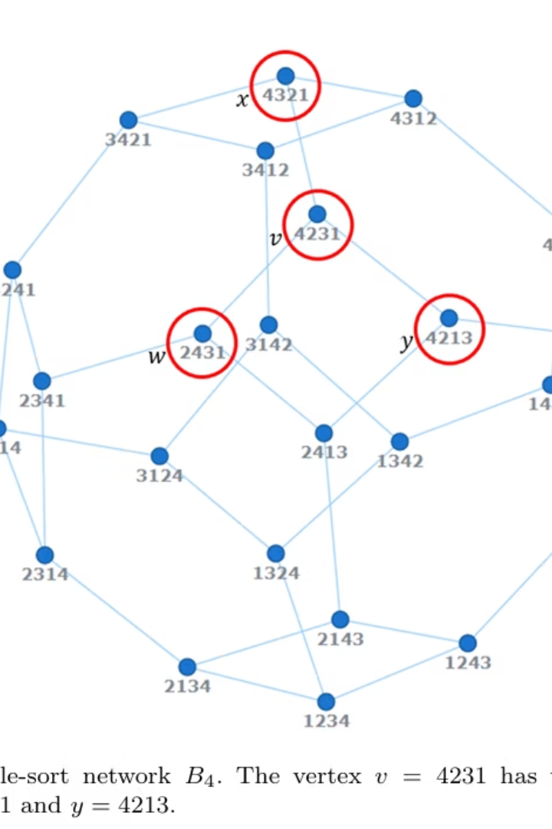
Paper Goal: Parallel MIST Algorithm for Bubble Sort Networks
Develop parallelizable MIST construction algorithm
Focus on Bubble Sort Network (Bₙ) topology

Slide 4
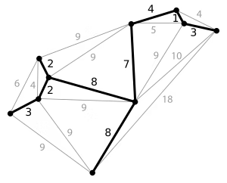
Terminology: Spanning Trees
Definition
Properties
Uses
Connects all nodes with no cycles
Includes all vertices
Routing backbones, broadcast trees, minimization of communication cost
No cycles; minimal edges

Slide 5
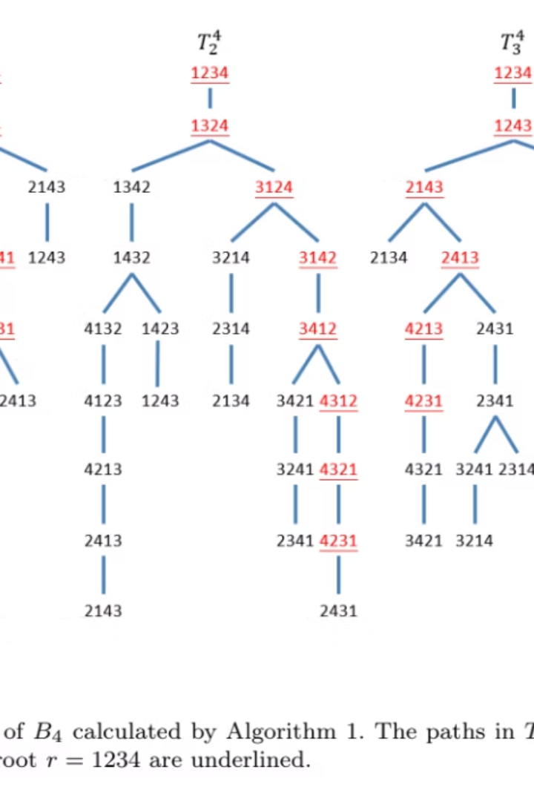
Terminology: Multiple Independent Spanning Trees (MISTs)
Definition
Set of independent spanning trees from same connected graph G
Properties
Valid spanning trees
Edge-disjoint or vertex-disjoint paths
Up to k trees in k-connected graph

Slide 6
MISTs: Key Uses in Network Design
Fault Tolerance
Parallel Routing
Node or edge failure in one tree doesn't disrupt network
Load balancing reduces congestion by multiple tree paths
Security & Resilience
Message splitting increases confidentiality and data loss resistance

Slide 7
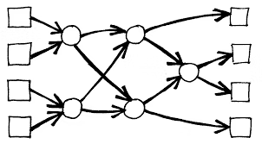
Terminology: Bubble-Sort Network (Bₙ)
Definition & Properties
Uses
Nodes are all permutations of n elements
Test routing algorithms
Edges represent adjacent swaps (transpositions)
Simulate broadcasting
Structured as a Cayley graph, connectivity n-1
Study network resilience
Diameter: n(n-1)/2

Slide 8
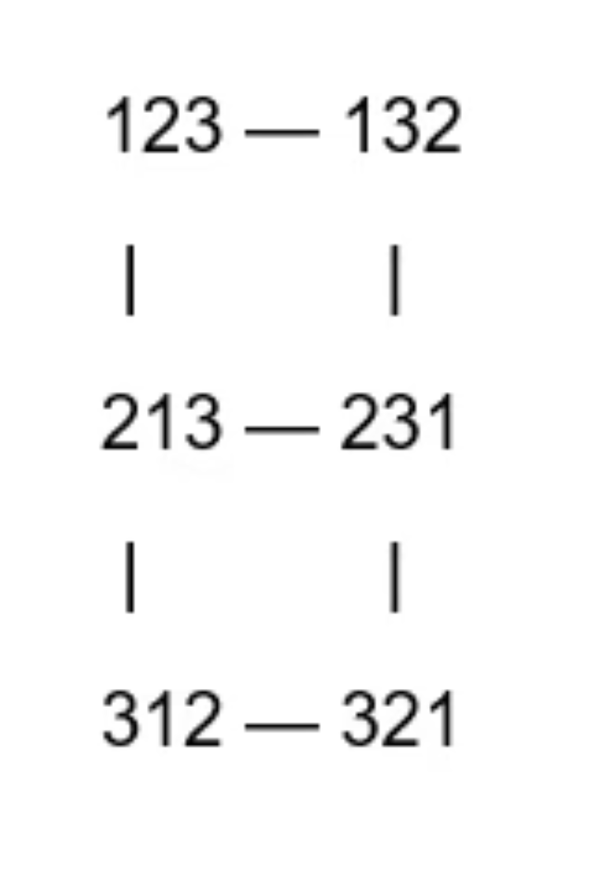
Bubble Sort Network Bₙ Example: Dimension 3
Permutations
{123, 132, 213, 231, 312, 321}
Edges
Each edge swaps adjacent elements (adjacent transpositions)

Slide 9
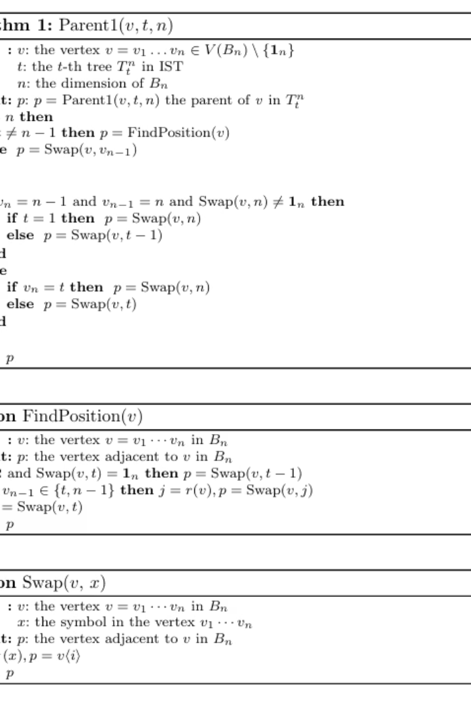
Algorithm Overview: Parallel Parent Computation
Core Function
Parent(v, t, n) computes vertex parent's location in tree Tₙᵗ
Preprocessing
Compute inverse permutation and first misplaced symbol position
Decision Rules
Swap based on tree index, misplaced symbol, or default position
Parallelism
Each vertex’s parent computed independently for parallelism

Slide 10
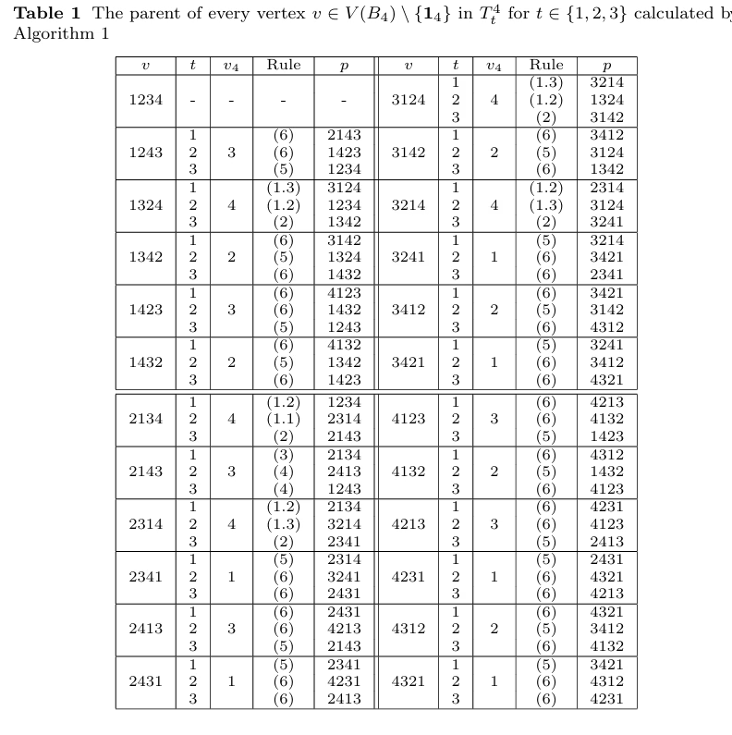
Results and Complexity
Time Complexity Analysis:
Per Vertex: O(n) time to compute parent
Total: O(n × n!) for all vertices in Bₙ
Parallelism:
Fully parallelizable — each vertex’s parent computed independently
Upper Bound:
Asymptotically optimal for Bubble Sort Network of size n!
Notes:
7

Slide 11
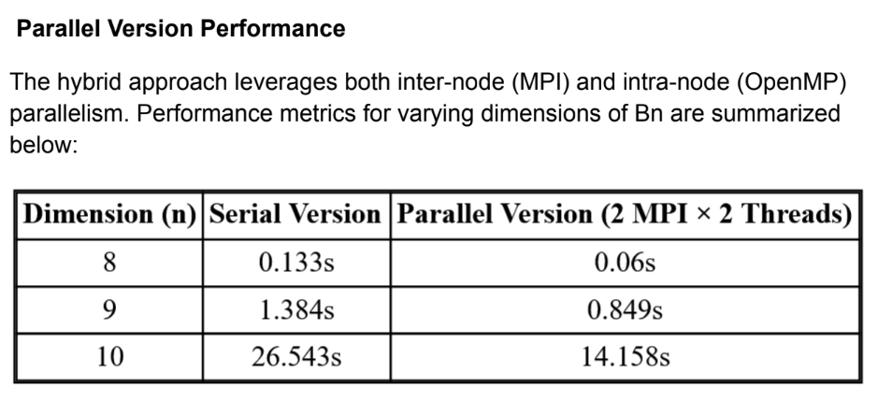

Slide 12

Proposed Solution: Inter-node Parallelism with MPICH
No Graph Partitioning Needed
Parent computation is fully local, no METIS required
MPICH for Inter-node Parallelism
Distributes spanning tree computation across multiple machines
Master assigns tree ranges to workers
Workers return constructed subtrees independently

Slide 13

Proposed Solution: Intra-node Parallelism with OpenMP
OpenMP Usage
Vertex-Level Parallelism
Parallelizes parent computation within each machine
Compute parents independently using OpenMP threads
No Synchronization Needed
Iterations are independent; no locking required

Slide 14

Conclusion
Presented a non-recursive, parallel algorithm for ISTs in Bn.
Hybrid parallel strategy ensures full scalability and fast local computation.

